Slide 1
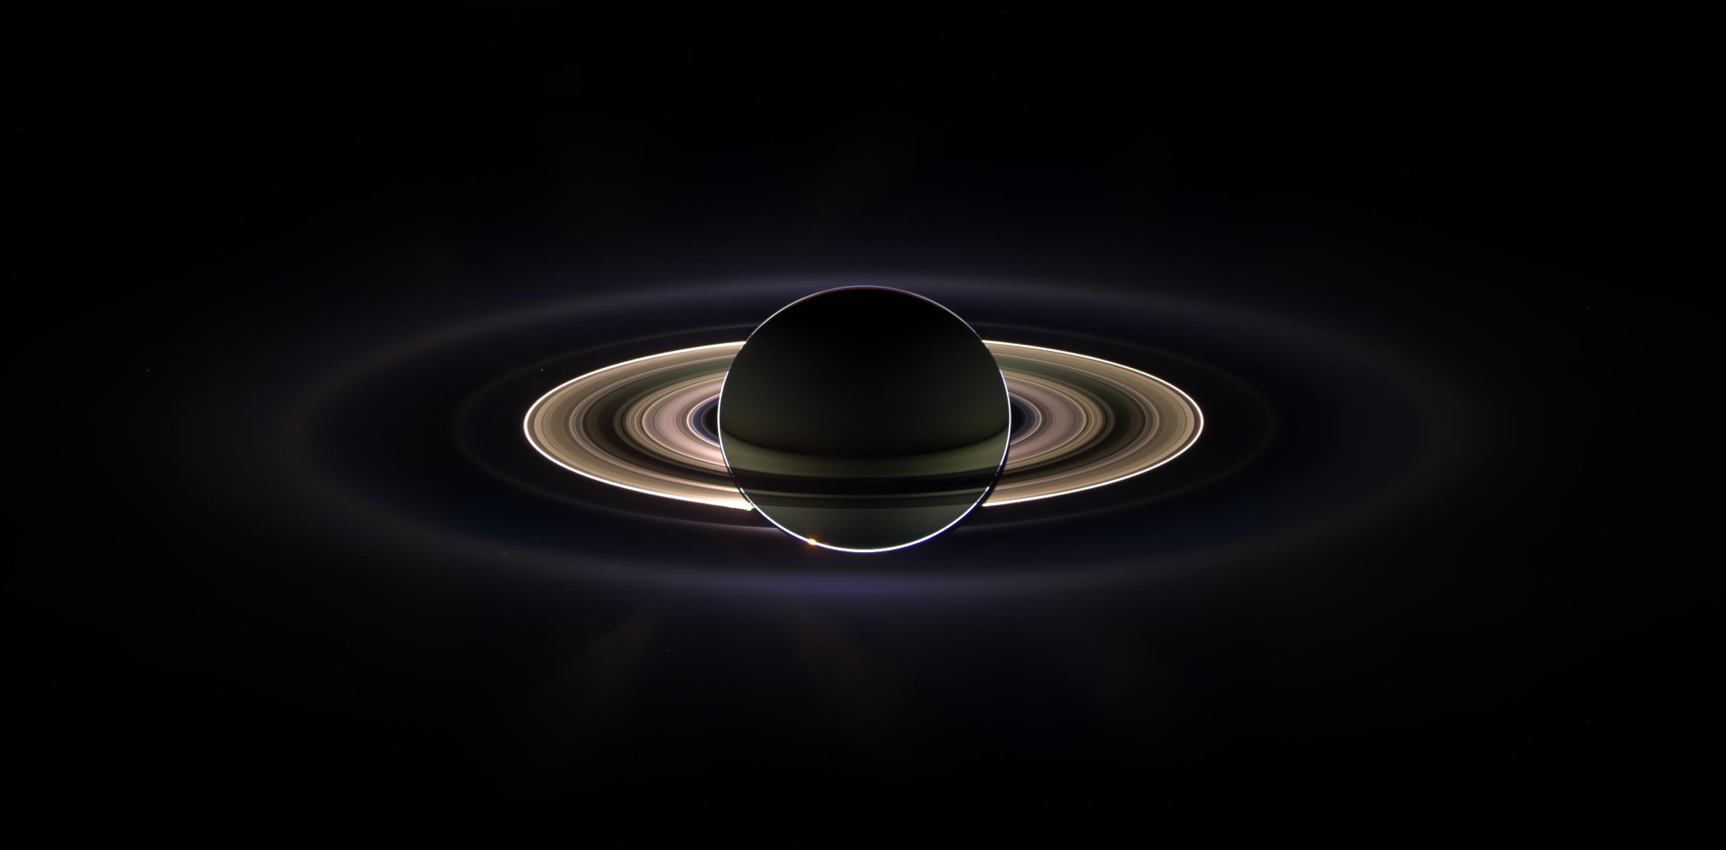
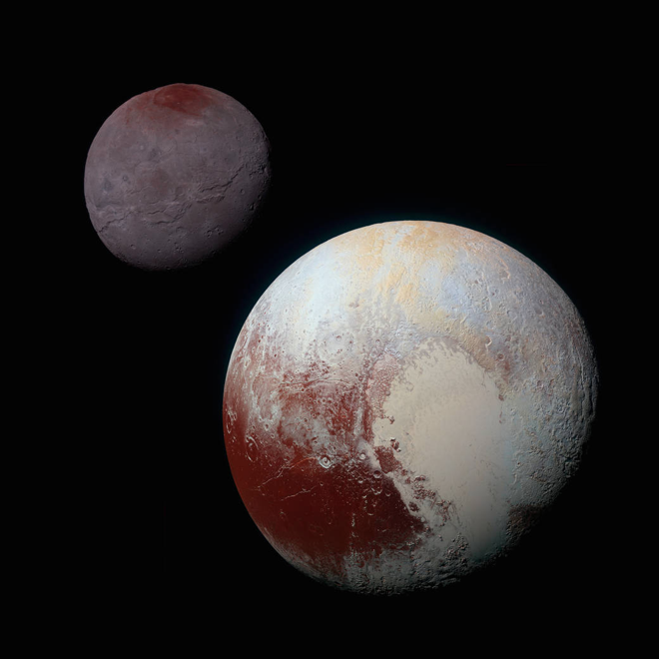
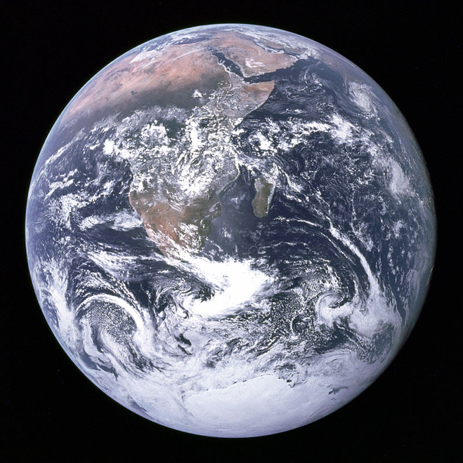

ASTR 101: Introduction to Astronomy The Solar System
Dr. Colin S. Wallace
Lecture 24: Line Spectra Formation
March 10, 2017

Slide 2
Announcements
Homework 6 available for pick-up at the front
Homework 8 is due Wednesday, March 22
Midterm 2: Friday, March 24 in class
40 multiple choice questions
Buy a Scantron sheet from Students Stores (20¢ per Scantron)
I will have 50 Scantron forms for sale on the day of the exam for 25¢
The Cosmic Perspective reading: Sections 5.4 (pp. 150-160)

Slide 3
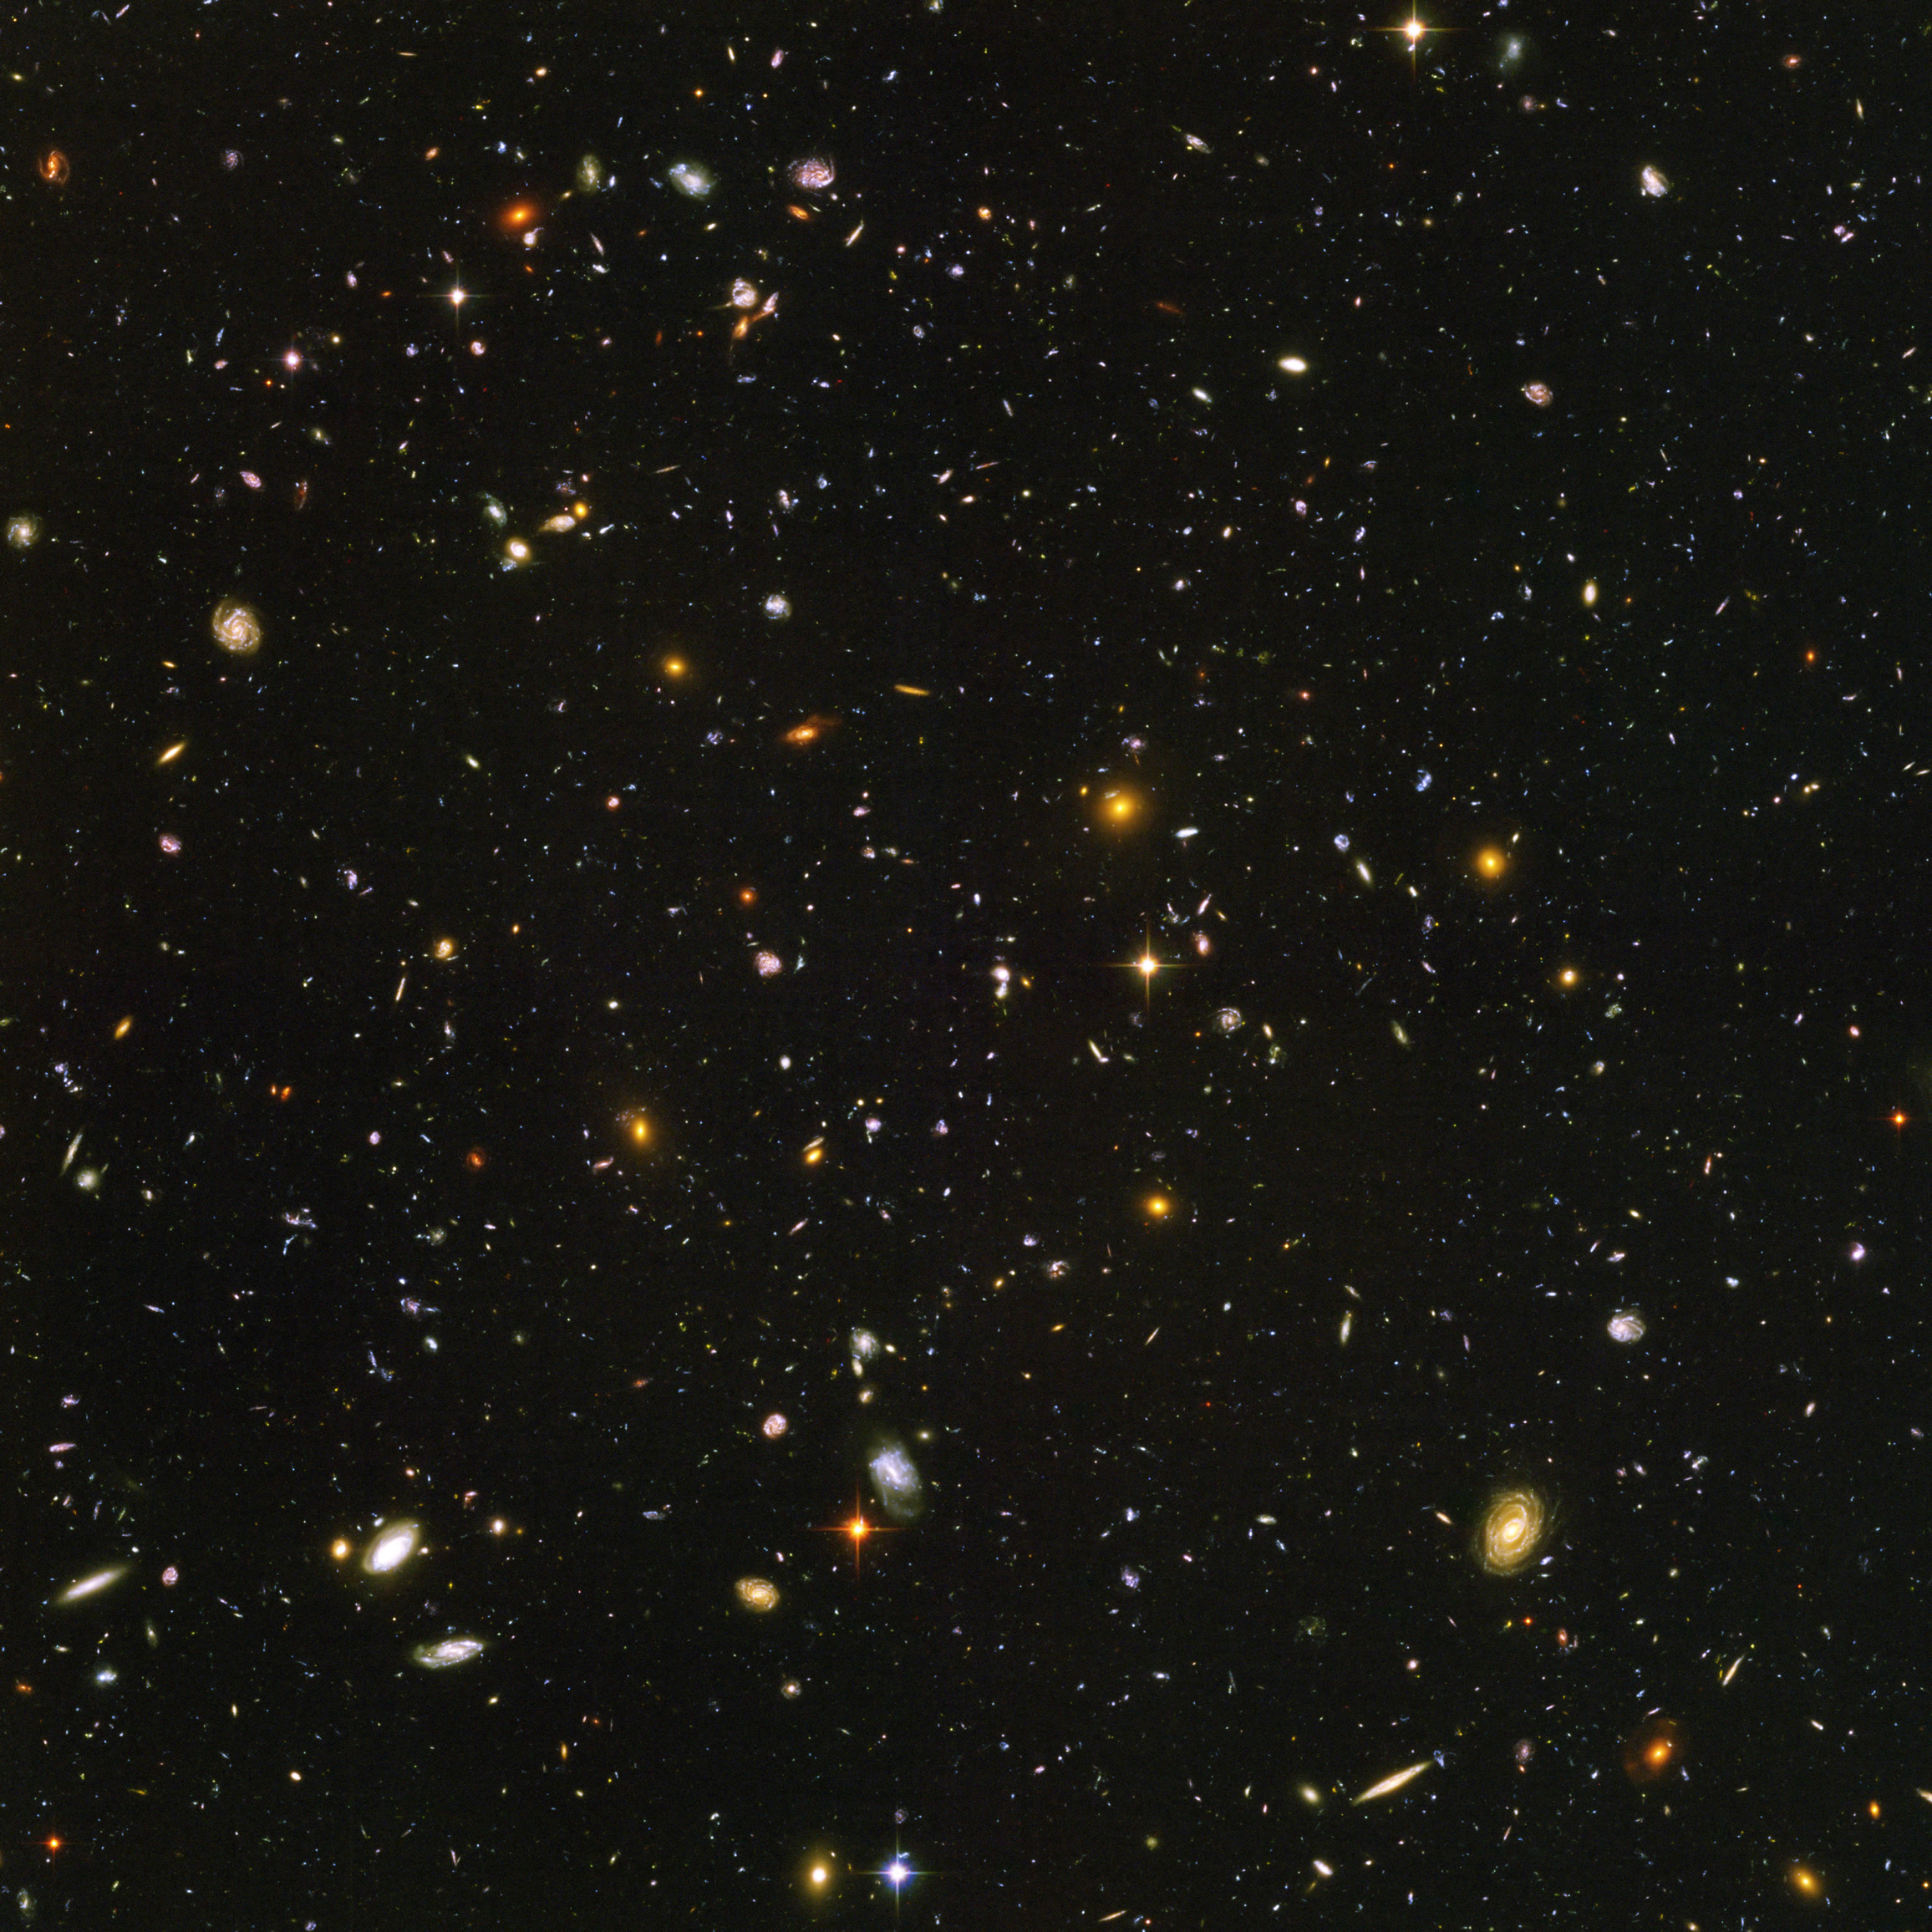
Lecture-Tutorial – Light and Atoms (pp. 65-69)
Work with a partner.
Read the instructions and the questions carefully.
Discuss the concepts and your answers with each other. Take the time to understand the material now. It WILL help you on the final exam.
Come to a consensus on your answer before you both move on to a new question.
If you are stuck or are not sure of your answer, ask another group.
If you are really stuck or don’t understand what the tutorial is asking, raise your hand and ask for help.

Slide 4
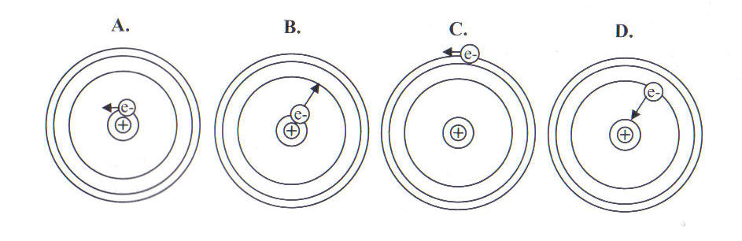
Which picture shows the process by which an absorption line forms?
E) more than one of the above
Notes:
B

Slide 5
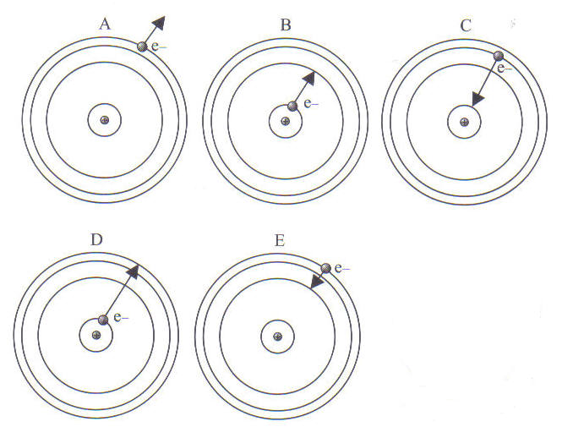
In which picture would the atom emit a photon with the most energy?
Notes:
C

Slide 6
In which picture would the atom emit a photon with the longest wavelength?
Notes:
E

Slide 7
In-class writing: Feedback on the course
What aspects of the course would you like to see continue?
What aspects of the course would you like to see change?
What would help you be more successful/continue your success?
Other comments?

Slide 8
Molecules
2 or more atoms bonded together
Molecules produce emission and absorption spectra in 3 different ways
Electrons in atoms change energy levels
The molecule changes how fast it’s vibrating
The molecule changes how fast it’s rotating

Slide 9
Molecular Electron Transitions and the Emission and Absorption of Visible and UV Light
Just like atoms, molecules can emit light when an electron transitions from a high energy level to a low energy level, and they can absorb light when an electron transitions from a low energy level to a high energy level
emission spectrum
absorption spectrum
short wavelengths
long wavelengths
short wavelengths
long wavelengths
Notes:
Visible + UV

Slide 10
Molecular Vibrations and the Emission of Infrared Light
When a molecule transitions from a faster vibration (higher energy state) to a slower vibration (lower energy state), the molecule emits a photon of light with an energy equal to the energy difference between the molecule’s two vibrational energy states.
The more arcs, the faster the molecule vibrates.
The greater the change in the number of arcs, the greater the change in energy.
This leads to an emission spectrum.
IR photon
X-ray UV Vis IR Radio
Notes:
Be sure to remind students that white = light and dark = no light

Slide 11
Molecular Vibrations and the Absorption of Infrared Light
A molecule can also transition from a slower vibration to a faster vibration when it absorbs a photon with an energy equal to the energy difference between the molecule’s two vibrational energy states.
The more arcs, the faster the molecule vibrates.
The greater the change in the number of arcs, the greater the change in energy.
This leads to an absorption spectrum.
IR photon
X-ray UV Vis IR Radio

Slide 12
Which of the following represents the molecule that is absorbing the lowest energy infrared photon?
Notes:
D

Slide 13
Molecular Rotations and the Emission of Radio Light
When a molecule transitions from a faster rotation (higher energy state) to a slower rotation (lower energy state), the molecule emits a photon of light with an energy equal to the energy difference between the molecule’s two rotational energy states.
The longer the arrow, the faster the molecule rotates.
The greater the change in the arrows’ lengths, the greater the change in energy.
This leads to an emission spectrum.
radio photon
X-ray UV Vis IR Radio

Slide 14
Molecular Rotations and the Absorption of Radio Light
A molecule can also transition from a slower rotation to a faster rotation when it absorbs a photon with an energy equal to the energy difference between the molecule’s two rotational energy states.
The longer the arrow, the faster the molecule rotates.
The greater the change in the arrows’ lengths, the greater the change in energy.
This leads to an absorption spectrum.
radio photon
X-ray UV Vis IR Radio

Slide 15
Which of the following represents the molecule that is emitting the highest energy radio photon?
Notes:
A

